Slide 1
Apache Cassandra
Prof Jigna Patel
CSE Department, Institute of Technology
Nirma University

Slide 2


Slide 3
What is Apache Cassandra?
It is scalable, fault-tolerant, and consistent.
It is a column-oriented database.
Its distribution design is based on Amazon’s Dynamo and its data model on Google’s Bigtable.
Created at Facebook, it differs sharply from relational database management systems.
Cassandra implements a Dynamo-style replication model with no single point of failure, but adds a more powerful “column family” data model.
Cassandra is being used by some of the biggest companies such as Facebook, Twitter, Cisco, Rackspace, ebay, Twitter, Netflix, and more.
Notes:
Apache Cassandra is an open-source no SQL database that is used for handling big data. Apache Cassandra has the capability to handle structure, semi-structured, and unstructured data. Apache Cassandra was originally developed at Facebook after that it was open-sourced in 2008 and after that, it become one of the top-level Apache projects in 2010.

Slide 4
Cassandra - Architecture
All the nodes in a cluster play the same role. Each node is independent and at the same time interconnected to other nodes.
Each node in a cluster can accept read and write requests, regardless of where the data is actually located in the cluster.
When a node goes down, read/write requests can be served from other nodes in the network.

Slide 5
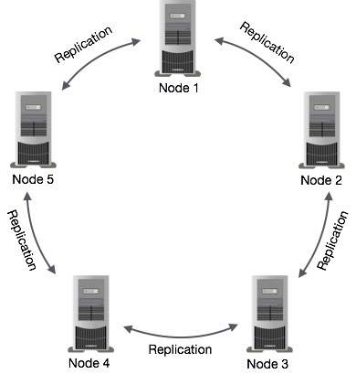
Data Replication in Cassandra
Notes:
In Cassandra, one or more of the nodes in a cluster act as replicas for a given piece of data. If it is detected that some of the nodes responded with an out-of-date value, Cassandra will return the most recent value to the client. After returning the most recent value, Cassandra performs a read repair in the background to update the stale values.
The following figure shows a schematic view of how Cassandra uses data replication among the nodes in a cluster to ensure no single point of failure.

Slide 6
Cassandra Query Language
Users can access Cassandra through its nodes using Cassandra Query Language (CQL).
CQL treats the database (Keyspace) as a container of tables. Programmers use cqlsh: a prompt to work with CQL or separate application language drivers.
Clients approach any of the nodes for their read-write operations. That node (coordinator) plays a proxy between the client and the nodes holding the data.

Slide 7
Write Operations
Every write activity of nodes is captured by the commit logs written in the nodes. Later the data will be captured and stored in the mem-table. Whenever the mem-table is full, data will be written into the SStable data file.
Read Operations
During read operations, Cassandra gets values from the mem-table and checks the bloom filter to find the appropriate SSTable that holds the required data.

Slide 8
Cassandra - Data Model
Cluster
Cassandra database is distributed over several machines that operate together. The outermost container is known as the Cluster.
Keyspace
Keyspace is the outermost container for data in Cassandra. The basic attributes of a Keyspace in Cassandra are −
Replication factor
Replica placement strategy
Column families
Notes:
Cassandra database is distributed over several machines that operate together. The outermost container is known as the Cluster. For failure handling, every node contains a replica, and in case of a failure, the replica takes charge. Cassandra arranges the nodes in a cluster, in a ring format, and assigns data to them.

Slide 9
The syntax of creating a Keyspace is as follows −
CREATE KEYSPACE Keyspace name
WITH replication = {'class': 'SimpleStrategy', 'replication_factor' : 3};

Slide 10
Data Models of Cassandra and RDBMS
RDBMS | Cassandra
RDBMS deals with structured data. | Cassandra deals with unstructured data.
It has a fixed schema. | Cassandra has a flexible schema.
In RDBMS, a table is an array of arrays. (ROW x COLUMN) | In Cassandra, a table is a list of “nested key-value pairs”. (ROW x COLUMN key x COLUMN value)
Database is the outermost container that contains data corresponding to an application. | Keyspace is the outermost container that contains data corresponding to an application.
Tables are the entities of a database. | Tables or column families are the entity of a keyspace.
Row is an individual record in RDBMS. | Row is a unit of replication in Cassandra.
Column represents the attributes of a relation. | Column is a unit of storage in Cassandra.
RDBMS supports the concepts of foreign keys, joins. | Relationships are represented using collections.

Slide 11
Thank You

Slide 12
References
https://www.tutorialspoint.com/cassandra
https://cassandra.apache.org/
https://www.datastax.com/products/apache-cassandra
https://www.guru99.com/cassandra-tutorial.html

Slide 13
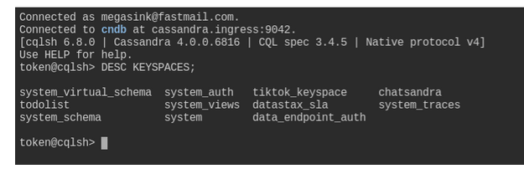
CASSANDRA-CRUD
Step 1. Navigate to the CQL Console and login to the database
Step 2. Describe keyspaces and USE one of them
DESC KEYSPACES;
"desc" is short for "describe", either is valid.
CQL commands usually end with a semicolon ;. If you hit Enter, nothing happens and you don't even get your prompt back, most likely it's because you have not closed the command with ;. If in trouble, you can always get back to the prompt with Ctrl-C and start typing the command anew.

Slide 14
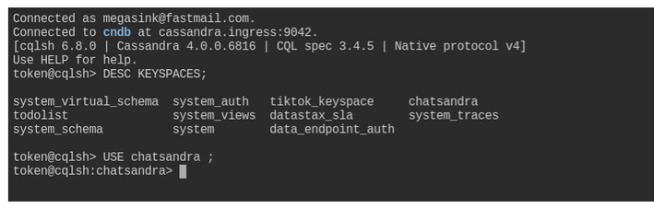
Depending on your setup you might see a different set of keyspaces than in the image. The one we care about for now is chatsandra. From here, execute the USE command with the chatsandra keyspace to tell the database our context is within chatsandra.
USE chatsandra;
Step 3. Create the users table
At this point we can execute a command to create the users table.

Slide 15
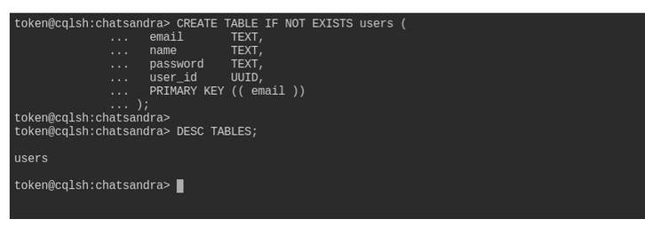
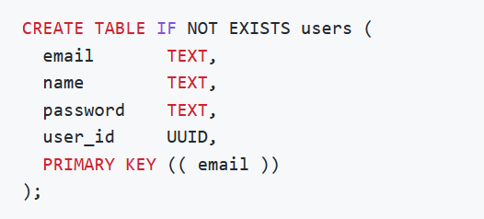
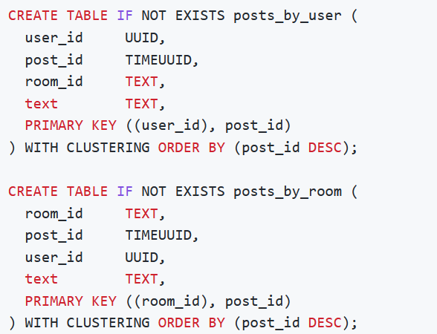
DESC TABLES;
Step 4: Create the tables for posts
Let us create two more tables, which will contain the posts. As remarked earlier, we will store the posts in two tables which differ in how they are partitioned: look at the commands below, the differences mostly lie in the PRIMARY KEY specification:
first look at the application's needs, determine the required workflows, then map them to a number of queries, finally design a table around each query.
We create table posts_by_user to support a query such as "get all posts by a user X"; then we also need table posts_by_room for a query of type "get all posts in room Y".
The two tables have the same columns, but the different choice of partition key is what will make the two queries possible on the respective tables.

Slide 16
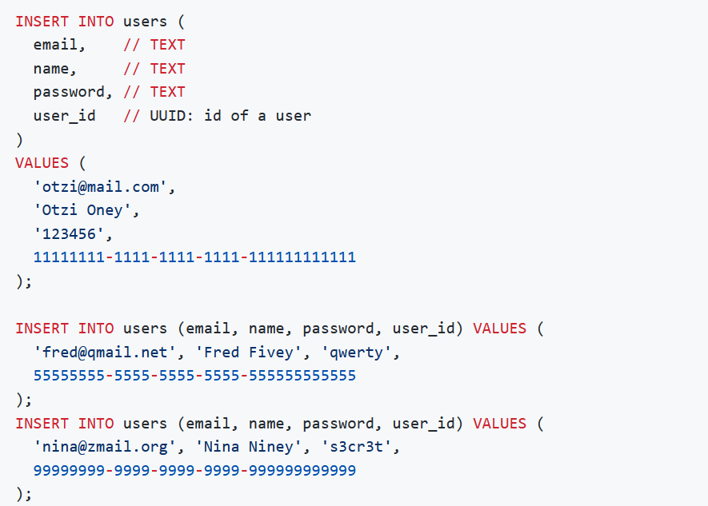
Execute CRUD operations
(C)RUD :
Our tables are in place so let's put some data in them. This is done with the INSERT statement. We'll start by inserting three rows into the users table.

Slide 17
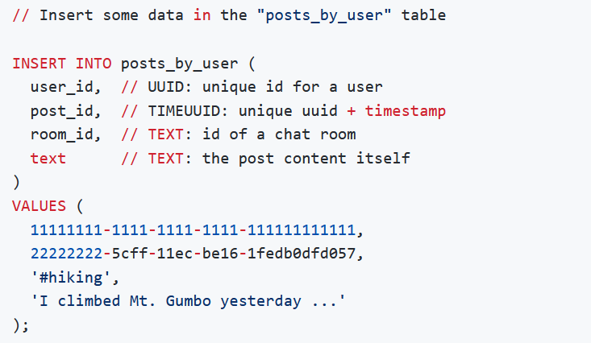
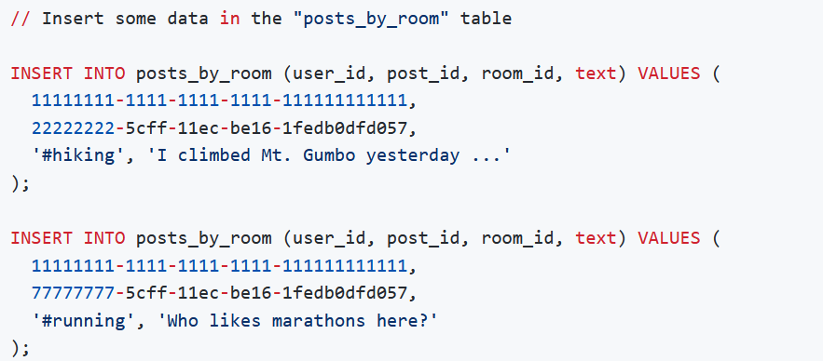

Slide 18
C(R)UD

Slide 19
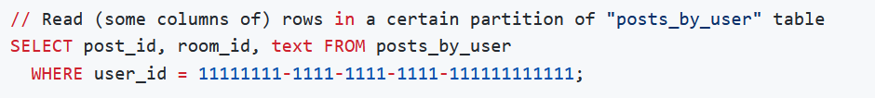
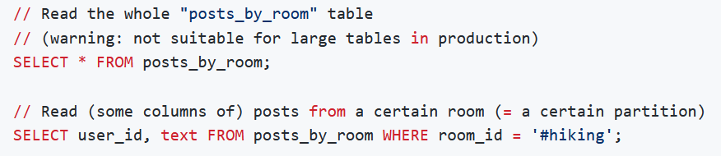
The key is to ensure we are always selecting by some partition key at a minimum, so to avoid the dreaded full-cluster scans which yield performances that are generally unacceptable in production.

Slide 20
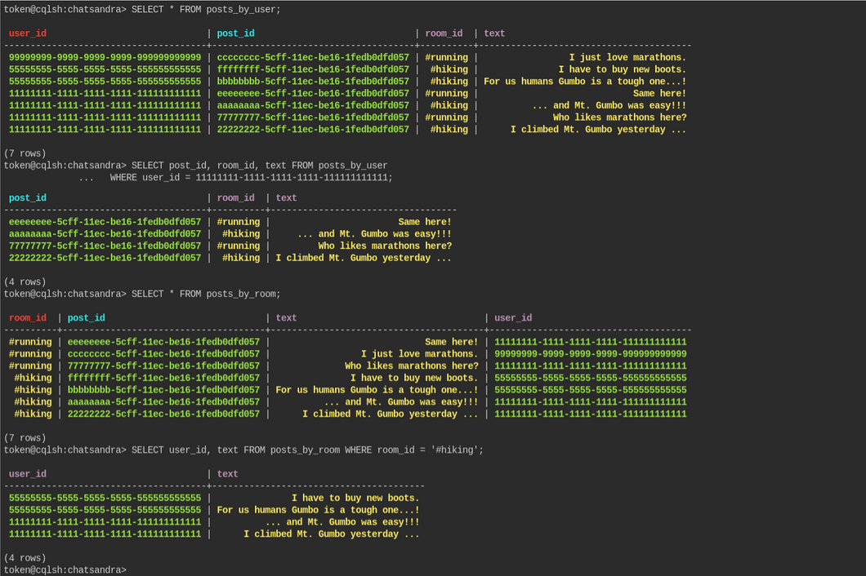

Slide 21
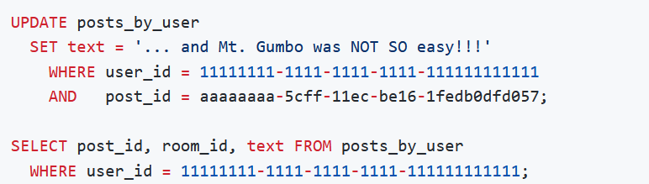
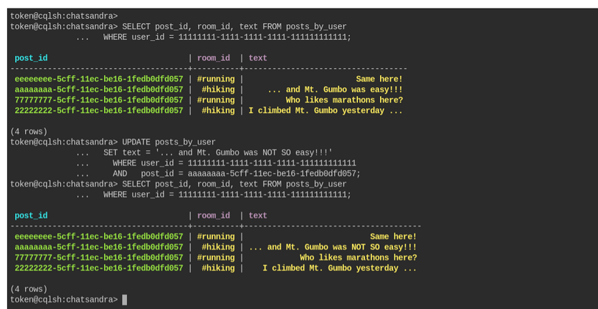
CR(U)D

Slide 22
CRU(D)
The final operation from our CRUD acronym is DELETE. This is the operation we use when we want to remove data from the database.
In Apache Cassandra you can DELETE from the cell level all the way up to the partition (meaning I could remove a single column in a single row or I could remove a whole partition) using the same DELETE command.
It's best to perform as few delete operations as possible on the largest amount of data. Think of it this way, if you want to delete ALL data in a table, don't delete each individual cell, just TRUNCATE the table. I
f you need to delete all the rows in a partition, don't delete each row, DELETE the partition, and so on.

Slide 23
